Slide 1
CSI2005 Principles of Compiler Design
MODULE - 4
Dr. WI. Sureshkumar
Associate Professor
School of Computer Science and Engineering (SCOPE)
VIT Vellore
wi.sureshkumar@vit.ac.in
SJT413A34

Slide 2
Module -6
Intermediate Code Generation
Intermediate Languages
Declarations
Assignment Statements
Boolean Expressions
Case Statements
Backpatching
Procedure Calls.

Slide 3
Intermediate code generator
A compiler while translating a source program into its equivalent object code representation, may first generate an intermediate representation.
The advantage of generating an intermediate representation are
Easy of conversion from source program to the intermediate code
Easy to do the subsequent processing from the intermediate code
The output of a parser is some representation of a parse tree. The intermediate code generation phase transforms this parse tree into an intermediate language representation.
Parse Tree
Intermediate code
Parser
Intermediate Code Generator
Code Generator

Slide 4
Intermediate Representations
There are three kind of intermediate representations
Syntax tree
Postfix notation
Three address code

Slide 5
Syntax tree
A syntax tree is a condensed form of parse tree useful for representing language constructs.
Example: syntax tree for a – 4 + c
+
c
-
a
4

Slide 6
Construction of syntax tree for expression
The construction of a syntax tree for an expression is similar to the translation of the expression into postfix form.
Each node in a syntax tree can be implemented as a record with several fields.
The following functions are used to create the nodes of a syntax tree for an expression with binary operators
mknode(op, left, right)
create an operator node with label op and two fields containing pointers to left and right
mkleaf( id, entry)
create an identifier node with label id and a field containing entry, a pointer to the symbol table entry of the identifier.
mkleaf( num, val)
create a number node with label num and a field containing val, the value of the number.

Slide 7
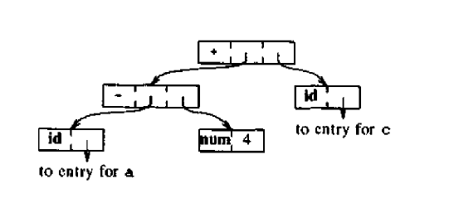
Construction of syntax tree for expression
The syntax tree for the expression a – 4 + c
P1 = mkleaf(id, entry_a)
P2 = mkleaf(num, 4)
P3 = mknode(“-”, P1, P2)
P4 = mkleaf(id, entry_c)
P5 = mknode(“+”, P3, P4)

Slide 8
DAG (Directed Acyclic Graph)
Identifies the common subexpression
A node N in a DAG has more than one parent
In a syntax tree, the common subexpression would be replicated as many times as the subexpression appears in the original expression

Slide 9
DAG for the expression
A DAG for the expression a + a * (b – c) + (b – c) * d
P1 = mkleaf(id, entry_a)
P2 = mkleaf(id, entry_a)
P3 = mkleaf(id, entry_b)
P4 = mkleaf(id, entry_c)
P5 = mknode(“-”, P3, P4)
P6 = mknode(“*”, P2, P5)
P7 = mknode(“+”, P1, P6)
P8 = mkleaf(id, entry_b)
P9 = mkleaf(id, entry_c)
P10 = mknode(“-”, P8, P9)
P11 = mkleaf(id, entry_d)
P12 = mknode(“*”, P10, P11)
P13 = mknode(“+”, P7, P12)

Slide 10
a + a * (b – c) + (b – c) * d
+
+
*
-
a
d
*
b
c
a
-
b
c

Slide 11
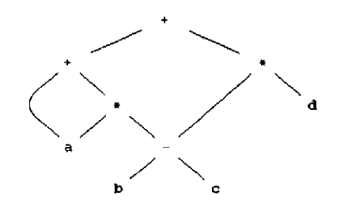

Slide 12
Postfix notation
a – 4 + c
a 4 – c +
a + a * (b – c) + (b – c) * d
a a b c – * + b c – d * +

Slide 13
Three address code
Three address code is a sequence of statements of the form
x := y op z
x, y, z are names, constants, or compiler generated temporaries and op stands for operator.
Ex: Three address code for the exp a + b * c + d
t1 = b * c
t2 = a + t1
t3 = t2 + d

Slide 14
Types of Three address statements
x = y op z (op is binary)
x = op y (op is unary)
x = y
goto L (unconditional jump to label L)
if x goto L and if False x goto L (conditional jump to label L)
if x relop y goto L

Slide 15
Types of Three address statements
– param x1
– param x2
– ...
– param xn
– call p, n ( procedure call p(x1 ,x2 ,... xn) )
x = y[i] or y = x[i] (Indexed copy)
x = & y, x = * y, and * x = y (Address and pointer
assignments)

Slide 16
Data structures for three address codes
Quadruples
Has four fields: op, arg1, arg2 and result
Triples
Temporaries are not used and instead references to instructions are made
Indirect triples
In addition to triples we use a list of pointers to triples

Slide 17
Quadruples, Triples and Indirect Triples
a = b * minus c + b * minus c
Three address code
Quadruples
Triples
Indirect Triples
op
arg1
arg2
result
op
arg1
arg2
minus
c
t1
op
op
arg1
arg2
t1 = minus c
t2 = b * t1
t3 = minus c
t4 = b * t3
t5 = t2 + t4
a = t5
0
minus
c
35
(0)
0
minus
c
*
b
t1
t2
1
*
b
(0)
minus
c
t3
36
(1)
1
*
b
(0)
2
minus
c
37
(2)
2
minus
c
*
b
t3
t4
3
*
b
(2)
+
t2
t4
t5
38
(3)
3
*
b
(2)
4
+
(1)
(3)
39
(4)
4
+
(1)
(3)
=
t5
a
5
=
a
(4)
40
(5)
5
=
a
(4)

Slide 18
Example: Three address code for a < b or c < d and e < f
100: if a < b goto 103 110 goto 112
101: t1 = 0 111 t3 = 1
102 goto 104 112 t4 = t2 and t3
t1 =1 113 t5 = t1 or t4
if c < d goto 107
t2 = 0
goto 108
t2 =1
if e < f goto 111
t3=0

Slide 19
Example:2
while (a < b) do 100 if a < b goto 102
if (c < d) 101 goto 110
x = y + z 102 if c < d goto 104
else 103 goto 107
x = y – z 104 t1 = y + z
105 x = t1
106 goto 100
107 t2 = y - z
108 x = t2
109 goto 100
110

Slide 20
Example: 3
while (a < c and b > d) do 10 if a < c goto 12 20 goto 10
if (a=1) 11 goto 24 21 t2 = a + 3
c = c + 1 12 if b > d goto 14 22 a = t2
else 13 goto 24 23 goto 19
while( a<= d) do 14 if a = 1 goto 16 24
a = a + 3 15 goto 19
16 t1 = c + 1
17 c = t1
18 goto 10
19 if a <= d goto 21

Slide 21
Example: 4
switch (i + j) 10 t1 = i + j 21 if t1 = 1 goto 12
{ 11 goto 21 22 if t1 = 2 goto 15
case 1: x = y + z; break; 12 t2 = y + z 23 goto 18
case 2: u = v + w; break; 13 x = t2 24
default: p = q + r; 14 goto 24
} 15 t3 = v + w
16 u = t3
17 goto 24
18 t4 = q + r
19 p = t4
20 goto 24

Slide 22
Example: 5
switch (a + b)
{
case 2: { x = y; break; }
case 5: { switch x
{
case 0: { a = b + 1; break;}
case 1: { a = b + 3; break;}
default: { a = 2; break;}
}
break;
case 9: { x = y - 1; break; }
default: { a = 2; break; }
}

Slide 23
10 t1 = a + b 21 a = 2 32 if t1 = 2 goto 12
11 goto 32 22 goto 36 33 if t1 = 5 goto 23
12 x = y 23 if x = 0 goto 15 34 if t1 = 9 goto 27
13 goto 36 24 if x = 1 goto 18 35 goto 30
14 goto 23 25 goto 21 36
15 t2 = b+ 1 26 goto 36
16 a = t2 27 t4 = y - 1
17 goto 36 28 x = t4
18 t3 = b + 3 29 goto 36
19 a = t3 30 a = 2
20 goto 36 31 goto 36

Slide 24
Syntax Directed Translation (SDT)
Most of the programming language constructs such as declarations, expressions, control flow statements, Boolean expressions are implemented by CFG
While implementing these constructs the productions of the grammar are not sufficient, some more additional information is required.
So we associate each production with some informal notation called semantic rules.
Productions with semantic rules is called Syntax Directed Translation.

Slide 25
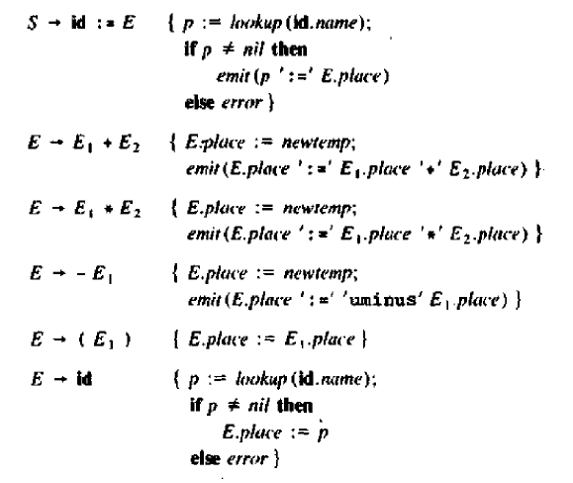
SDT for Assignment statement

Slide 26
a := b + c * d
a := b + c * d
a = b + c * d
t1 = c * d
t2 = b + t1
a = t2
S
S
:=
b + c * d
:=
E
id
E
id
a
+
E
c * d
E
id
*
E
E
b
id
id
d
c

Slide 27
SDT for Expressions
E → E + T { E.val := E.val + T.val}
E → T { E.val := T.val}
T → T * F { T.val := T.val * F.val}
T → F { T.val := F.val}
F →id { F.val := num.lexval}

Slide 28
5 + 6 * 4
E
E
+
T
T
*
F
T
F
F
id
4
id
id
5
6

Slide 29
E.val = 5 + 24 = 29
5 + 6 * 4
E.val = 5
+
T.val = 6 * 4 = 24
T.val = 5
*
F.val = 4
T.val = 6
F.val = 5
F.val = 6
id
4
id
id
5
6

Slide 30
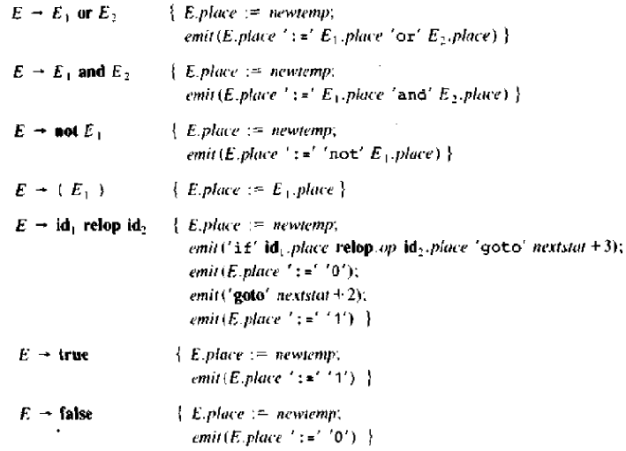
SDT for Boolean Expression

Slide 31
Example: Three address code for a < b or c < d and e < f
100: if a < b goto 103 110 goto 112
101: t1 = 0 111 t3 = 1
102 goto 104 112 t4 = t2 and t3
t1 =1 113 t5 = t1 or t4
if c < d goto 107
t2 = 0
goto 108
t2 =1
if e < f goto 111
t3=0

Slide 32
SDT for Flow of Control Statements

Slide 33
if (B.code) if (B.code)
{ {
B.true: B.true:
} }
B.false: goto S.next
{
B.false:
}
S.next:

Slide 34
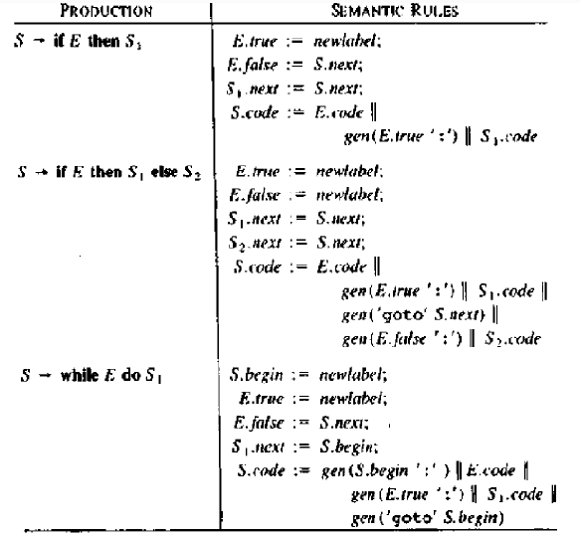

Slide 35
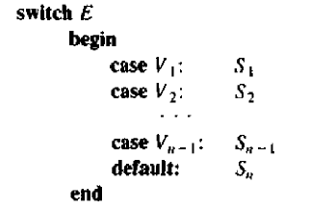
SDT for Flow of Control Statements

Slide 36
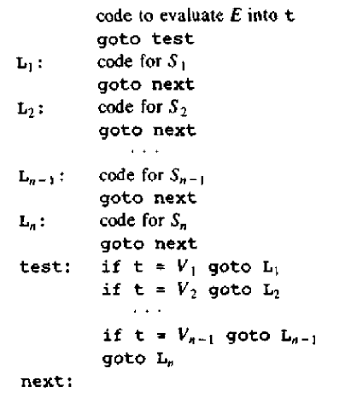

Slide 37
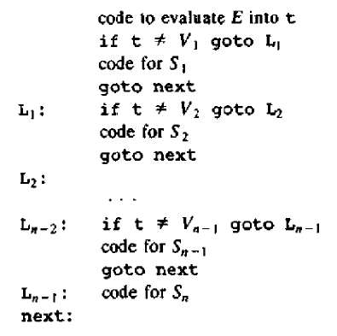

Slide 38
SDT for Declarations
D → TL { L.type := T.type}
T → int { T.type := int}
T → real { T.type := real}
L → L₁,id { L₁.type := L.type}
{ enter(id.ptr, L.type)
L →id {enter(id.ptr, L.type)}

Slide 39
int id1, id2, id3
D
L. type = T. type = int
L
L. type = T. type = int
T
T. type = int
int
,
id
L
L. type = int
,
id
L
L. type = int
id

Slide 40
Back-patching
To implement SDT is to uses two passes. In the first pass, construct the syntax tree for the input. In the second pass, walk through the tree in depth first order, computing the translation in the definition.
The main problem for generating three address code for Boolean statement and flow of control statements in a single pass we may not know the labels that control must go to at the time the jump statements are generated.
We can solve this problem by generating a series of branching statements with target of the jumps temporarily unspecified.
Each such statement will be put on a list of goto statements whose label will be filled in when the proper label can be determined.
We call this subsequent filling in of labels backpatching.

Slide 41
We show how backpatching can be used to generate code for Boolean expression in one pass.
To manipulate list of labels, we use three functions:
makelist(i) - creates a new list containing only i, an index into the
array of quadruples.
merge(p₁, p₂) – concatenates the lists pointed to by p₁ and p₂ , and
returns a pointer to the concatenated list.
backpatch(p, i) – inserts i as the target label for each of the statements
on the list pointed to by p.

Slide 42
Boolean Expressions
E → E1 or M E2
E → E1 and M E2
E → not E1
E → (E1)
E → id₁ reop id₂
E → true
E → false
M → ε

Slide 43
Consider the production E → E1 and M E2 .
If E1 is false, then E is also false, so E1.falselist become part of E.falselist.
If E1 is true, then we must next test E2. So the target for the statements E1.truelist must be the beginning of the code generated for E2.
This target is obtained using the marker nonterminal M.
Attribute M.quad records the number of the first statement E2.code
With the production M → ε we associate the semantic action
{M.quad := nextquad}

Slide 44
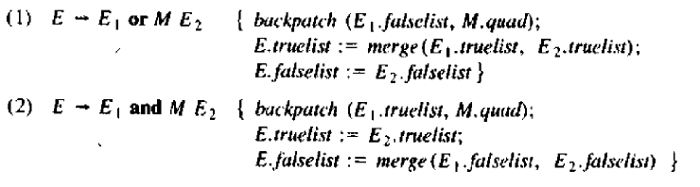
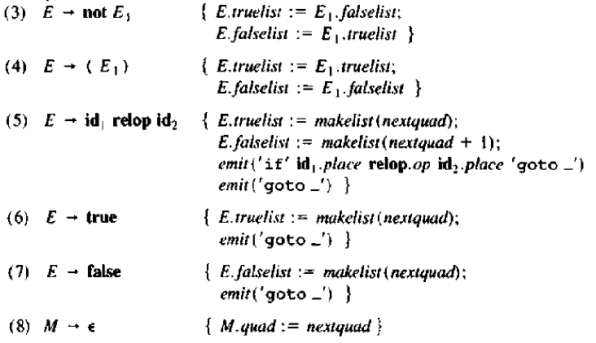

Slide 45
Example: a < b or c < d and e < f
Apply production (5) for a < b
100 if a < b goto ___
101 goto ___
Apply production (5) for c < d
102 if c < d goto ___
goto ___
Apply production (5) for e < f
104 if e < f goto ___
105 goto ___

Slide 46
E
or
M
E₁
E₂
ε
a
<
and
M
b
E₁
E₂
ε
c
<
d
e
<
f

Slide 47
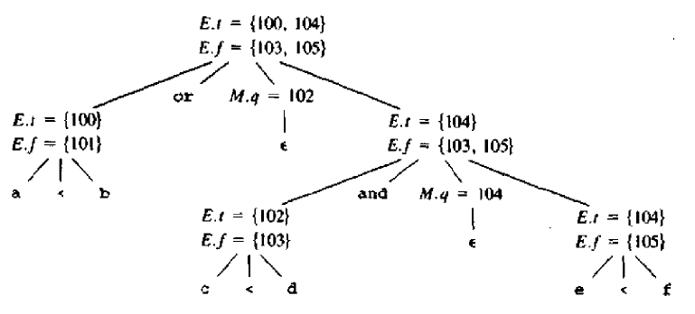

Slide 48
We now reduce E → E1 and M E2. The corresponding semantic action calls backpatch({102}, 104).
This call to backpatch fills in 104 in statement 102.
100 if a < b goto ___
101 goto ___
102 if c < d goto 104
goto ___
104 if e < f goto ___
105 goto ___

Slide 49
The semantic action associated with the final reduction E → E1 or M E2
calls backpatch({101}, 102).
This call to backpatch fills in 102 in statement 101.
100 if a < b goto ___
101 goto 102
102 if c < d goto 104
goto ___
104 if e < f goto ___
105 goto ___

Slide 50
The entire expression is true if and only if the goto’s of statements 100 and 104 are reached.
The entire expression is false if and only if the goto’s of statements 103 and 105 are reached.
These instructions will have their targets filled in later in the compilation when it seen what must be done depending on the truth or false value of the expression.

Slide 51
Procedure calls
Consider a grammar for a simple procedure call statement
S → call id ( Elist ) { for each item p on queue do
emit(‘param’ p)
emit(‘call’ id.place, Elist.count) }
(2) Elist → Elist , E {append E.place at the end of the queue
Elist.count = Elist.count + 1}
(3) Elist → E {Initialize queue to contain only E.place
Elist.count = 1 }

Slide 52
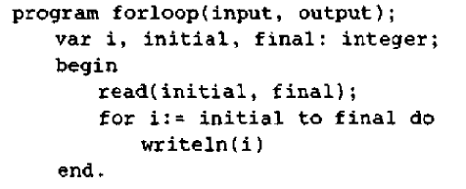
Example:
param initial
param final
call read , 2
S
call
id
(
)
Elist
read
,
E
initial
final
Elist
final
E
initial

